Slide 1

Cortana Vulnerability Research and Exploitation
Version 3.2
12/5/22
Noble Team - Melanie Brown, Marwan Elashry, Viren Kumar, Tanya Malik, Emily Nolan, and Lucas Scharf
Sponsor - Chase Whitt
Mentor - Dr. Coffman

Slide 2
Section 1: Executive Summary
Cortana is a text and voice enabled virtual assistant that was developed by Microsoft to perform tasks like setting reminders and answering questions by using the Bing search engine. Recent studies have shown that Cortana is recording and transmitting sounds and conversations that are occurring nearby. Lockheed Martin wants to know the possible security consequences of this problem, as well as the size of the attack surface and vulnerabilities.
The Noble’s team goal is to investigate this privacy issue with Cortana by using penetration testing and reverse engineering. During the 8 months given we should be done with the 3 phases of this project, research, execution and exploitation.
Authored By: Marwan Elashry

Slide 3
Section 2: Description of the Problem
Cortana has been proven to be vulnerable to packet modification from the previous group with a low percentage success rate. They used a pre installed CA certificate to modify these packets. Cortana can also activate randomly to record audio and send it to the server. Lockheed Martin is asking us to research vulnerabilities in Cortana that may allow it to be exploited. Lockheed has also asked us to look at the vulnerabilities of transmitting voice data with Cortana’s current packet structure.
Microsoft is trying to expand Cortana to productivity tasks. Using voice data that can be captured could potentially put companies at unnecessary risk.
Authored By: Lucas Scharf

Slide 4
Objectives
Reproduce and Verify Past Results - We will be using past teams deliverables to reproduce and verify their results to gain a better understanding of our starting point and what we can expand upon (End of September)
Research - Further research known vulnerabilities and faults using Microsoft documents and updates for Windows 11 (Early / Late Fall)
Testing - Using Wireshark/Burpsuite to dynamically test the code to find and verify the vulnerabilities (Late Fall / Early Spring)
Architecture Design- Developing a demo and reverse engineering report (Late Fall / Early Spring)
Verify Effectiveness- Test solution in a working environment and modify as needed (Spring)
Authored by: Emily Nolan
Notes:
Research is continuous not completed

Slide 5
Section 4: Technical Approach

Slide 6
Section 4.1: Requirements
We shall verify the results of the previous group.
We shall research vulnerabilities and how they were exploited using:
Microsoft documentation, open source tools, static testing, and prior conducted research.
We shall determine what attack vectors are more likely to occur.
We shall execute a browser exploit.
We shall combine the Man-in-the-Middle (MITM) attack with the browser exploit to “steal” login credentials.
Authored By: Melanie Brown & Viren Kumar
Notes:
Say fake landing page
As for the requirements, we shall:
verify the findings of the previous group
Research vulnerabilities and how they are exploited using microsoft's documentation, open source tools for static and dynamic testing, along with prior conducted research
We shall also determine what attack vectors are more likely to occur
We will execute a browser exploit
And finally, we will combine a man in the middle attack with the browser exploit to steal login credentials.

Slide 7
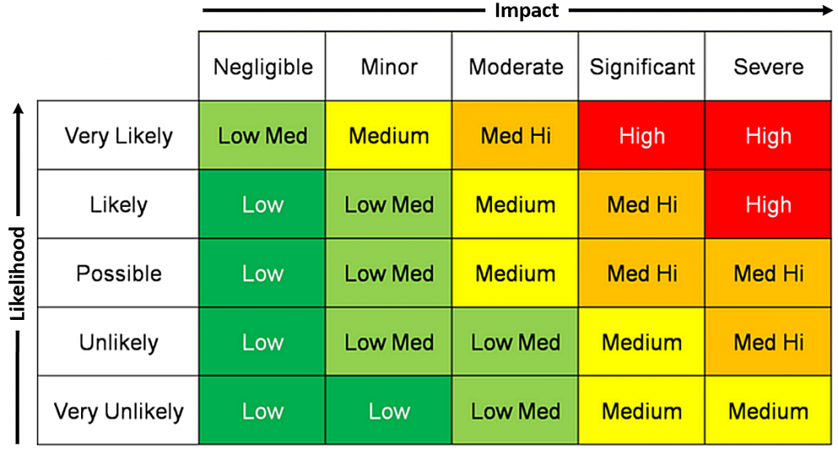
Section 4.2: Risks
Risks | Likelihood | Impact
If a virtual environment is not being used or set up properly, then the host systems could be at risk | Unlikely | Significant
If files are edited outside of the virtual machine, then the system could be at risk | Unlikely | Significant
Subject to Man-in-the-Middle (MITM) | Possible | Moderate
Possible phishing / website redirection | Possible | Significant
Exposed sensitive information | Likely | Moderate - Significant
Authored By: Emily Nolan & Melanie Brown
Notes:
2 charts don't relate
EMILY DO THIS
Risks to us simulating the attack:
If a virtual environment is not being used or set up properly, then the host systems could be at risk
If files are edited outside of the virtual machine, then the system could be at risk
Risks to the user using Cortana right now:
Subject to Man-in-the-Middle (MITM)
Possible phishing / website redirection
Exposed sensitive information

Slide 8
Section 4.3 Design Constraints
Virtual Machines (VM)
Using a Virtual machine to conduct our exploit does not give us a accurate user testing environment
Open Source Tools
We are limited to the free version of many open source tools which slightly limits our abilities when testing
Windows Updates
Both Windows 10 and 11 get updated regularly which could put our findings and the chances of a real world successful attack out of date quickly
Inability to duplicate settings in demo
the team will need to research and rebuild the environment
Cortana updates
Require to rebaseline
Damaged system or files
The timeline for the project could be delayed or requirements may not be met
If duplicating settings takes too long to rebuild, then the team will need to find a different way to attack Cortana
Authored By: Emily Nolan
Notes:
EMILY DO THIS

Slide 9
Section 4.4: Concept of Operations (CONOPS)
Execute MITM attack on Windows machine
Using Burp Suite, Wireshark, and Ettercap
Monitor and send through HTTP requests
Execute browser exploit
Inject “malicious” web page
Combining
Leverage MITM to execute browser vulnerability and take user to new web page
Record their credentials
Authored By: Emily Nolan
Notes:
As for out concept of operations we are planning on executing a MITM attack on the Windows machine Using Burp Suite, Wireshark, and ettercap. We are also planning to inject a malicious web page within Cortana’s response to a user inputted question. Lastly, we are going to leverage the MITM attack to execute a browser vulnerability which will allow us to record user inputted credentials.

Slide 10
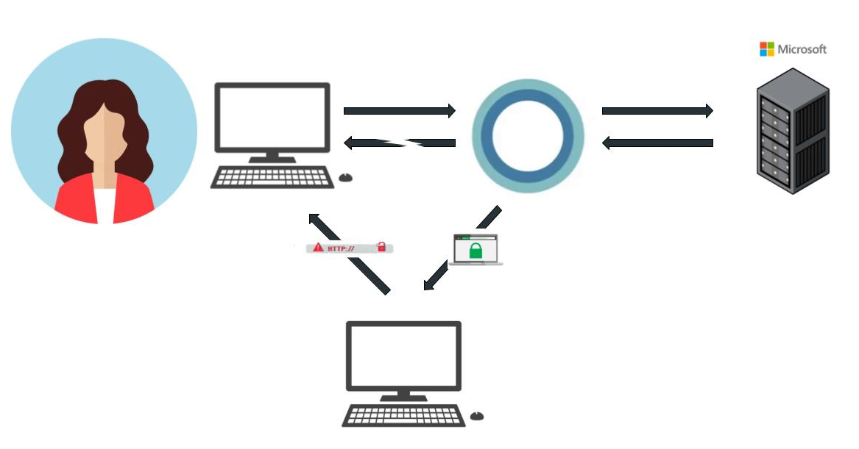
Section 4.4 (Cont.): CONOPS
USER
CORTANA
MICROSOFT SERVER
SEND REQUEST
SEND REQUEST
SEND RESPONSE
SEND RESPONSE
SEND MODIFIED RESPONSE
MODIFY RESPONSE
Authored By: Viren Kumar & Emily Nolan
MitM
Notes:
This is a visual of the concept of the operations. The user askes cortana a question, cortana sends the question to microsoft servers. The server sends a response back to cortana. Before cortana sends it back to the user, we implement the man in the middle attack and inject our own webpage which is then sent to the user.

Slide 11
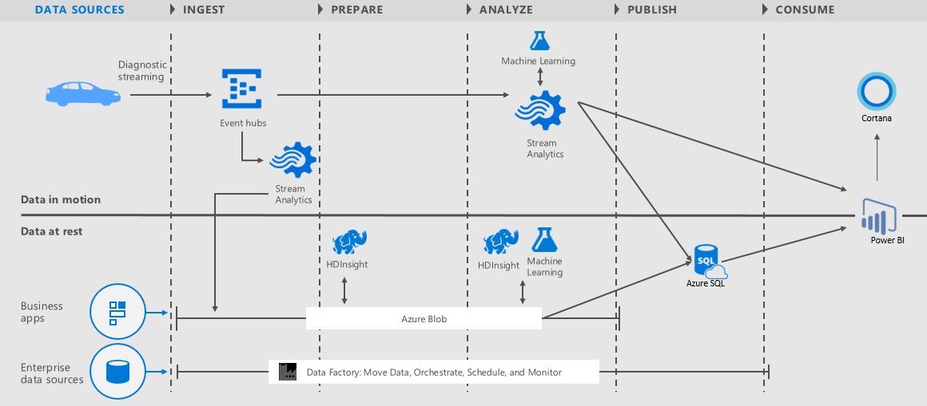
Section 4.5: Architecture - Standard Cortana Configuration
Authored By: Lucas Scharf
https://social.technet.microsoft.com/wiki/contents/articles/36688.introduction-to-cortana-intelligence-suite.aspx

Slide 12
Section 4.5: Architecture - Man-in-the-Middle
Authored By: Lucas Scharf
https://social.technet.microsoft.com/wiki/contents/articles/36688.introduction-to-cortana-intelligence-suite.aspx

Slide 13


Section 4.6: Data Model
Microsoft, Check this.
Give me a second to come up with a response.
.
Hello, Cortana.
How can I help you, user?
User Say/type Hello Cortana then input whatever is on their mind (either text or audio).
Cortana says hello back then immediately starts to transmits the data the user inputted to their servers for processing.
The servers at Microsoft analyzes the data then sends back a response to the user.
Authored by: Marwan Elashry

Slide 14

Section 4.7: Verification Method
Put into practice and test in Windows VM after combining MITM attack with browser exploit
Monitor Cortana's response to asked questions and effectiveness in bringing up fake landing page to the user
Attack achieved goal if login is successful
Attack was unsuccessful if login to real website fails
We will modify attack and retest as needed
Authored By: Emily Nolan & Tanya Malik

Slide 15
Section 4.8: Expected Results
Discover methods to building on what previous years students have already completed, including their future goals.
Improve process of implementing browser exploits.
Improve process to decrypt and analyze saved audio messages.
Possibly use credentials to bring user back to real webpage to “cover tracks” - once the keys are logged and user selects the login button, our version of the website will have the login button hyperlink to an actual GMU login page where they are forced to re-enter their credentials.
Authored By: Viren Kumar
Notes:
We expect to discover methods to build on what previous years students have completed, along with their future goals. We also expect to improve on the process of implementing browser exploits and decrypting and analyzing saved audio messages. We also plan on masking our exploit by redirecting the user to the real gmu login page, after we store the credentials.

Slide 16
Section 4.9: Major Tasks
Recreate last year’s demo
Reproduce the set up from last year
Transport Layer Security (TLS) handshake capture and decryption
Recreate browser exploit with working landing page
Combine last year’s exploit with browser exploit
Testing our research environment
Analyse packets of data from Cortana
Inject browser exploit to responses
Design architecture
Design and create demo
Authored By: Melanie Brown & Tanya Malik

Slide 17
Section 5: Equipment and Facilities
Cyber Tools (open-source)
Burp Suite & Certificate
Wireshark
Ettercap Graphical
Fiddler
Ghidra
Virtual Machines (free)
VirtualBox
Kali Linux
Windows 10
Windows 11
Authored By: Melanie Brown

Slide 18
Section 6: Deliverables
Weekly activity reports
Weekly customer reporting (LMH)
Reversing Process for Used Systems and Report
Design Review Briefing
Final Proposal
Draft Design Review
Design Review
Final Presentation and Report
Final Product Specifications
Final Sponsor Presentation and Sage Presentation
Authored By: Emily Nolan
Notes:
EMILY DO THIS

Slide 19
Section 7: Cost and Management

Slide 20
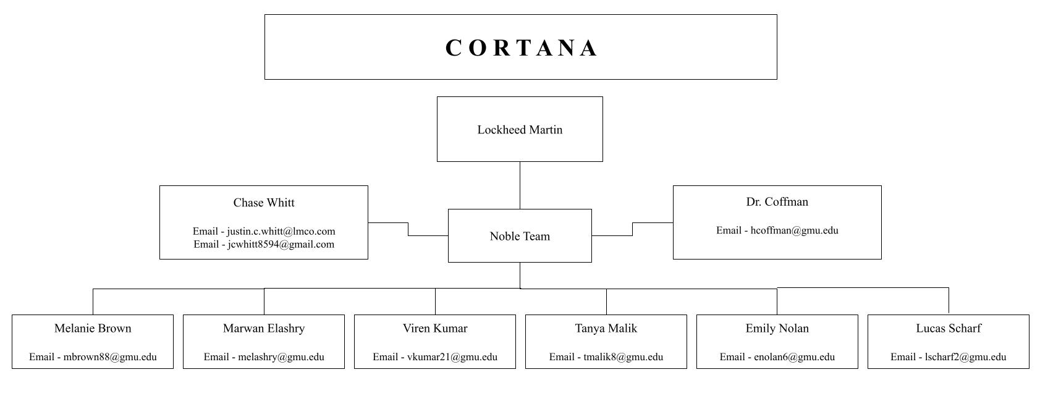
Section 7.1: Organization Chart
Authored By: Emily Nolan
Notes:
LHM thru chase
EMILY DO THIS

Slide 21
Section 7.2: Work Breakdown Structure
01
Verify Last Year’s Results
Confirm previous research findings
Reproduce the demo
02
Research Common Vulnerabilities and Exposures (CVE)
Research Windows 10 CVEs
Research Windows 11 CVEs
Research browser CVEs
03
Exploit CVE Through Cortana
Recreate browser exploit from CVE
Combine last year’s exploit with browser exploit
Host fake landing page with keylogger
Test and modify
04
Further Research of Cortana
Disassemble the Cortana dynamic link library (DLL)
Decrypt TLS traffic and audio packets
Improve decryption processes
05
Presentation And Demo
Conduct the demonstration
Sage competition
Authored By: Melanie Brown

Slide 22
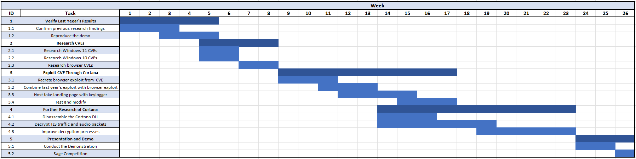
Section 7.3: Project Schedule
Authored By: Melanie Brown

Slide 23
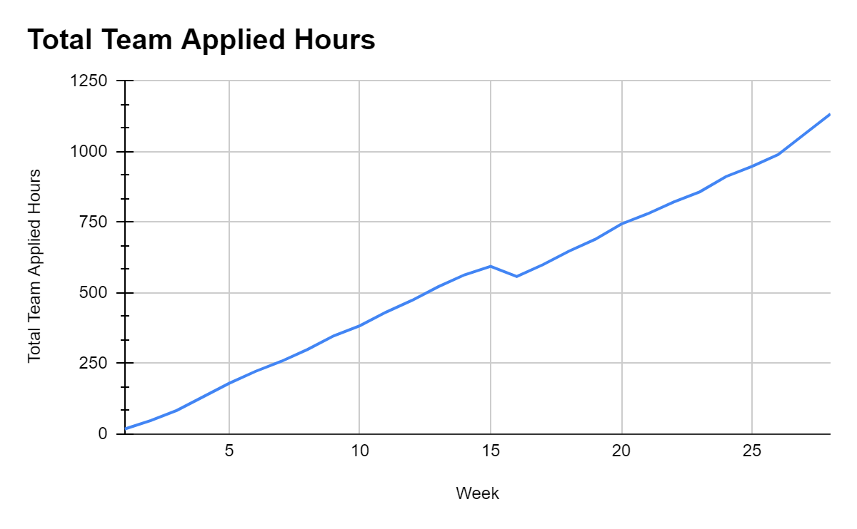
Section 7.4: Cost and Management Summary
Averaging 5-9 hours per week for each team member
1,134 hours in total (~550 each semester)
Authored By: Emily Nolan
Notes:
EMILY DO THIS

Slide 24
Section 8: Next Steps
Further develop research found on vulnerabilities and recreate/test them ourselves in a sandbox.
Host a fake GMU landing page for the browser exploit.
Keylog credentials from custom made GMU login page and plug them into the real GMU login page, or other services that possibly utilize the same credentials (Gmail, Instagram, etc).
Continue self learning of Cortana’s files:
Find publicly accessible program database (PDB) files to further investigate the exe files in Cortana using Ghidra.
Audio Packet Decryption in Wireshark.
Authored By: Viren Kumar
Notes:
As for next steps, we will implement the research we found individually on vulnerabilities along with recreate and test them. We will also host the fake GMU landing page so it can be accessed remotely rather than only locally. Next we will store keylogged information online rather than on the local affected machine as we would like to repurpose those credentials. And lastly, we eventually would like to find publicly accessible program database files to further understand what Cortana’s executable files really do.

Slide 25
Thank you
Questions?

